Slide 1
K-NEAREST NEIGHBORS (KNN)

Slide 2
1. What is KNN
K-Nearest Neighbors (KNN) is a supervised, instance-based, non-parametric learning algorithm used for classification and regression.
It makes predictions by looking at the K closest data points in the training set.

Slide 3
2. Purpose
To predict the class or value of a data point based on similarity to nearby data points.

Slide 4
3. Why it is Used
Simple and intuitive
No training phase
Works well with small datasets
Effective when decision boundary is irregular

Slide 5
4. How KNN Works (Algorithm)
Step-by-Step:
Choose the value of K
Compute distance between test point and all training points
Select the K nearest neighbors
Aggregate their outputs:
Classification → majority vote
Regression → mean/median
Output final prediction

Slide 6
5. Distance Metrics
Distance | Formula
Euclidean | D(A,B)=√∑i=1n​(Ai​−Bi​)2​
Manhattan | D(A,B)=∑i=1n​∣Ai​−Bi​∣
Minkowski | D(A,B)=(∑i=1n​∣Ai​−Bi​∣p)p1​
Cosine | ( 1 – {{x . y}/{|x||y|}} )

Slide 7
6. Formula / Mathematical Representation
Classification:
y^=mode{y1,y2,...,yK}
Regression:
y^=1/K∑i=1Kyi

Slide 8
7. Technical Details
Learning Type:
Lazy Learning (no explicit training)
Instance-based learning
Complexity:
Training time → O(1)
Prediction time → O(n⋅d)
Where:
n = number of samples
d = number of features

Slide 9
8. Parameters
Model Parameters:
Training dataset itself (stored in memory)
Hyperparameters:
Parameter | Meaning
n_neighbors (K) | Number of neighbors
distance metric | Euclidean, Manhattan, etc.
weights | Uniform / distance-based
algorithm | brute, kd-tree, ball-tree

Slide 10
9. Assumptions
Similar points have similar outputs
Distance metric captures similarity correctly
Features are properly scaled

Slide 11
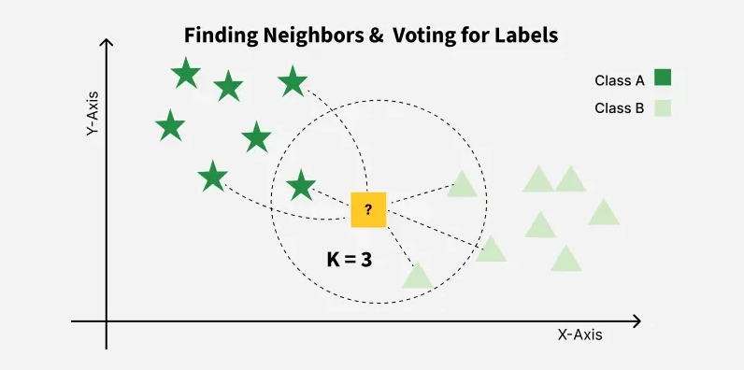

Slide 12
10. Pros
Simple to understand
No training required
Flexible decision boundaries
Adapts easily to multi-class problems

Slide 13
11. Cons
Computationally expensive at inference
Sensitive to feature scaling
Poor performance with high-dimensional data
Requires large memory
Sensitive to noise and outliers

Slide 14
12. KNN vs Other Models
Model | Key Difference
Logistic Regression | KNN is non-parametric
Decision Tree | KNN uses distance
SVM | KNN has no margin
Random Forest | KNN has no training

Slide 15
13. Real-World Applications
Recommendation Systems:
Movie & product recommendations
Healthcare:
Disease classification
Medical image analysis
Finance:
Credit risk assessment
Computer Vision:
Image similarity
Face recognition
Anomaly Detection:
Outlier detection

Slide 16
14. Best Practices
Always scale features
Choose odd K for binary classification
Use cross-validation to find K
Use distance-weighted voting

Slide 17
Summary
KNN is a simple, distance-based algorithm that predicts outputs by looking at the closest data points, trading training simplicity for inference cost.

